Slide 1


Group 69
Theo blauberg
Rasmus Rasmussen
Alexandros matakos

Slide 2
“The key to artificial intelligence has always been the (re)presentation.”
—Jeff Hawkins

Slide 3
Performance
Binary classification accuracy:
On train: 84.6%
On test: 90.2%
Our guess: 87%
Multi-class classification accuracy:
On train: 65.5%
On test: 73.7%
Perplexity: 1.63
Unofficial winners of the binary and multi-class classification challenge.

Slide 4
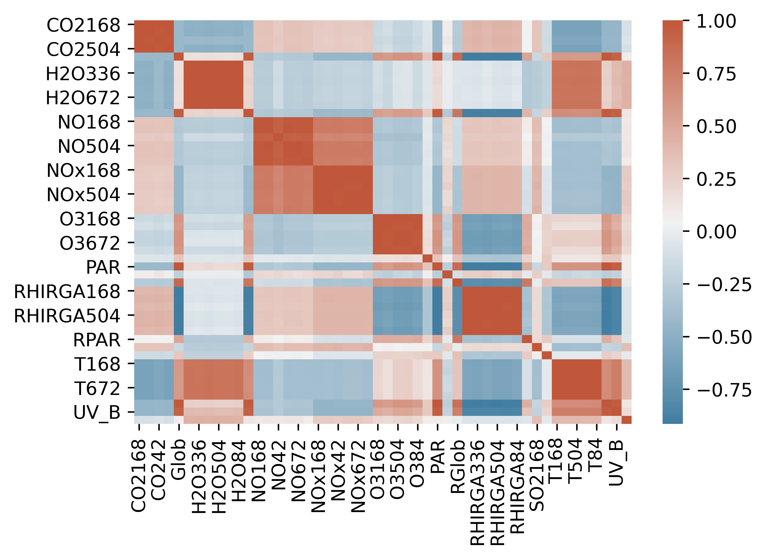
Feature selection
Data has over 100 variables
Many of them correlated!
We removed more than 80% of the variables

Slide 5
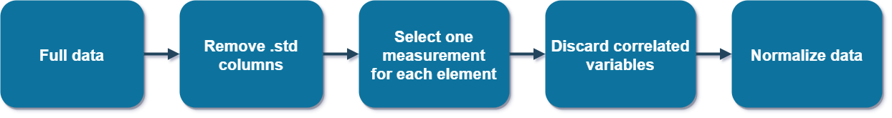
Feature selection

Slide 6
Methods
Supervised:
Support Vector Machine
Logistic Regression
Random Forest
Gradient Boosted Trees
Gaussian Naïve Bayes
Unsupervised:
K-means
PCA
Ended up going with SVM classifier with RBF kernel and C=3.75

Slide 7
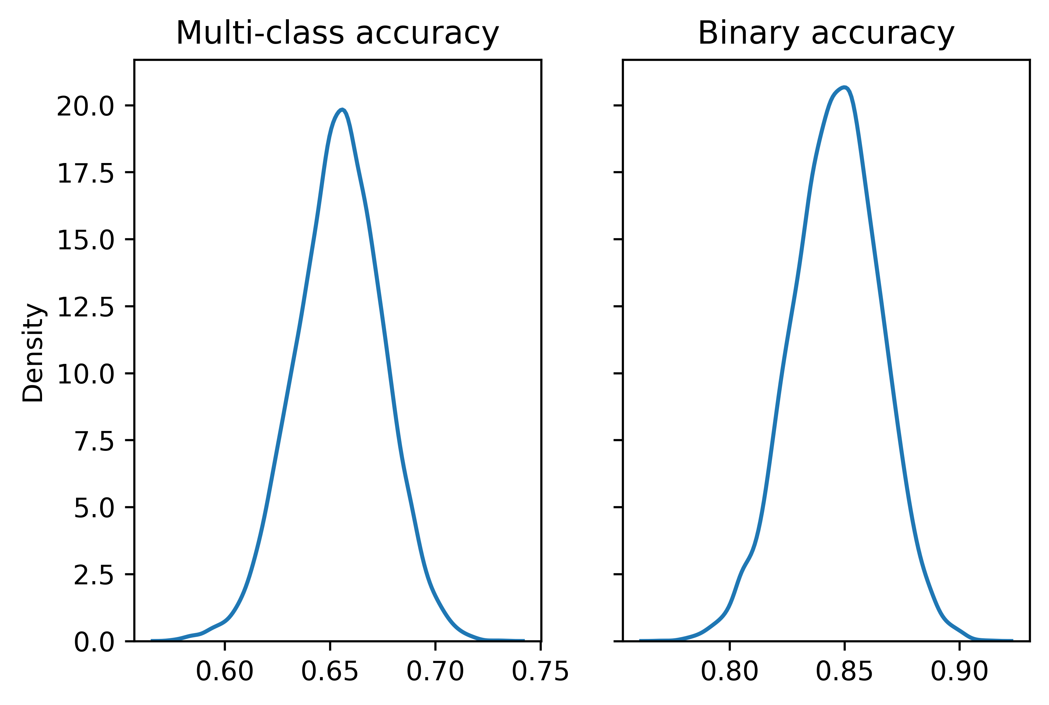
Validation
Event type Ia had too few observations
Came up with custom way of validation:
Separate data into train/test preserving class ratio
Fit and evaluate a model on each random split
Average out from 1000+ fits

Slide 8
Conclusion
Thank you very much for your attention!
Group 69

